Slide 1
Learning Management System for Northumbria University
Alistair Reynolds, Bradley Roddis, Fedaur Rahman, George Thompson & Miranda Besong

Slide 2
Introduction
Clear Ideas
Recommendation
Conclusion
Introduction
Introduction
Case Objectives
Case Objectives
Case Objectives
Research
Research
Conclusion
Recommendation
Conclusion
Appraisal
Recommendation
Clear Ideas
Clear Ideas
VISA Appraisal
Appraisal
Introduction
Overview of the case and organisation
Problem Identification
Clear Ideas Framework
VISA appraisal
Recommendations
Conclusion

Slide 3
Introduction
Clear Ideas
Recommendation
Conclusion
Introduction
Introduction
Case Objectives
Case Objectives
Case Objectives
Research
Research
Conclusion
Recommendation
Conclusion
Appraisal
Recommendation
Clear Ideas
Clear Ideas
VISA Appraisal
Appraisal
Business Case – LMS Northumbria University
Mission
To provide recommendations and rationale for a new Learning Management System (LMS) within Northumbria University.
We have chosen Northumbria University for the subject of our system implementation as we have greater access to the system and can provide a thorough analysis.
Vision
Ensure Learning Management System within the University utilise best practices to improve the communication, feedback and social learning, in order to enhance the user experience throughout the HE institution.

Slide 4
Introduction
Clear Ideas
Recommendation
Conclusion
Introduction
Introduction
Case Objectives
Case Objectives
Case Objectives
Research
Research
Conclusion
Recommendation
Conclusion
Appraisal
Recommendation
Clear Ideas
Clear Ideas
VISA Appraisal
Appraisal
LMS System Research
E-learning environments can have potential added learning benefits and can improve students' and educators' self-regulation skills, in particular their metacognitive skills.
Encourage the application of learners' metacognitive skills by prompting learners to plan, attend to relevant content, and monitor and evaluate their learning.
LMS incorporates features and functionalities that can provide extensive scaffolding to learners and support them in becoming self-regulated learners.
Centralize and automate administration.
Use self-service and self-guided services.
Assemble and deliver learning content rapidly
Consolidate training initiatives on a scalable Web-based platform.
Support portability and standards.
Personalize content and enable knowledge reuse.
(Dias & Diniz, 2014)
(Sclater, 2008)

Slide 5
Introduction
Case Objectives
Clear Ideas
Appraisal
Recommendation
Conclusion
Attribute Tree
Overall Objective
Sub-Objectives
Attributes
Mobile and Desktop Versions
Communication channels
Sub-Objectives: Functionality, Reliability & Interoperability
Distilled from major goals outlined through secondary research
Found that most attributes fit under all three objectives
Attributes
Attained from research into current LMS usage and Primary research into the Blackboard System used in Northumbria University.
Functionality
Pedagogical Gamification
User Feedback
User friendly UI
Conformity to regulations
Ideal LMS for Higher Education
Reliability
Maintenance Cost
Data security
Server efficiency
Personalisation
Interoperability
SCROM app connectivity
Modification
Access for all departments

Slide 6
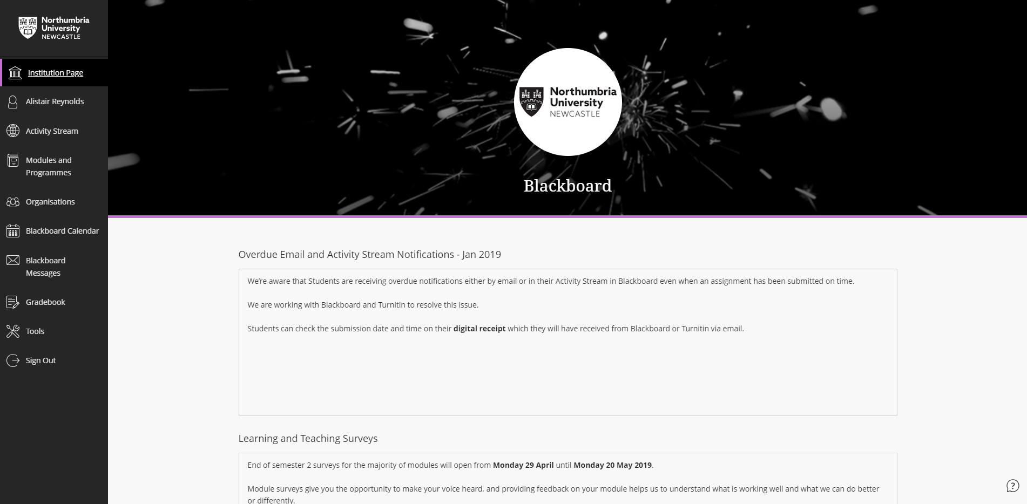
Introduction
Clear Ideas
Recommendation
Conclusion
Introduction
Introduction
Case Objectives
Case Objectives
Case Objectives
Research
Research
Conclusion
Recommendation
Conclusion
Appraisal
Recommendation
Clear Ideas
Clear Ideas
Appraisal
Appraisal
Current Student System
Format and Colour Scheme correlate across systems
Web-Based Platform
SCROM app compliance
Collaboration Tools
Activity Stream
Messaging System for Students
Learning Management Tools

Slide 7
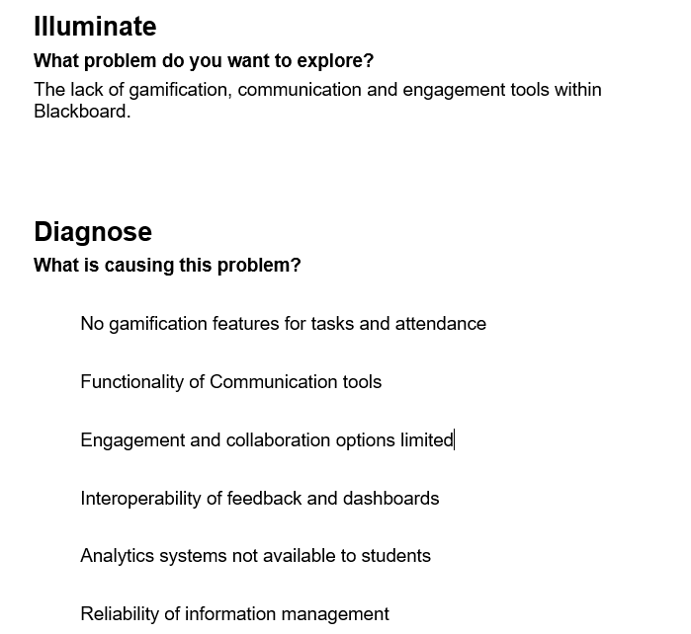
Introduction
Clear Ideas
Recommendation
Conclusion
Introduction
Introduction
Case Objectives
Case Objectives
Case Objectives
Research
Research
Conclusion
Recommendation
Conclusion
Appraisal
Recommendation
Clear Ideas
Clear Ideas
VISA Appraisal
Appraisal
Clear Ideas - Problem Identification
Refocus:
Lack of engagement and analytics systems which hinder collaboration options

Slide 8
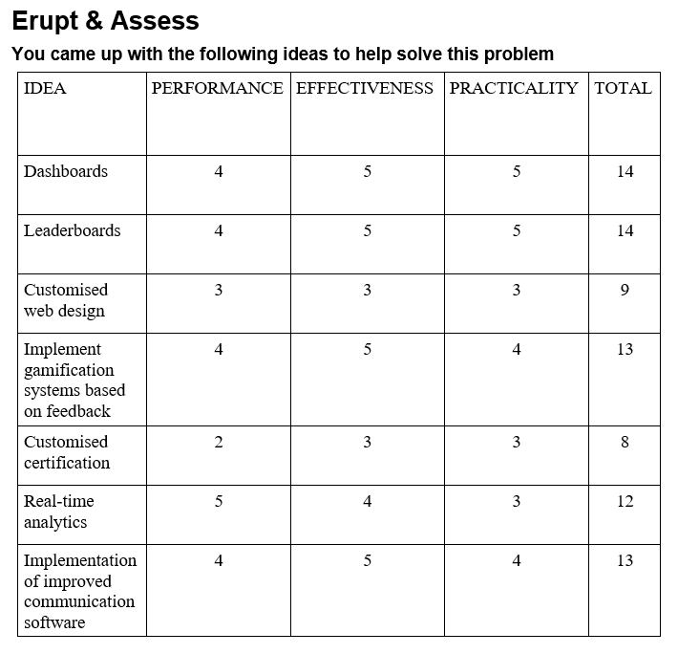
Introduction
Clear Ideas
Recommendation
Conclusion
Introduction
Introduction
Case Objectives
Case Objectives
Case Objectives
Research
Research
Conclusion
Recommendation
Conclusion
Appraisal
Recommendation
Clear Ideas
Clear Ideas
Appraisal
Appraisal
Clear Ideas – Idea Generation

Slide 9
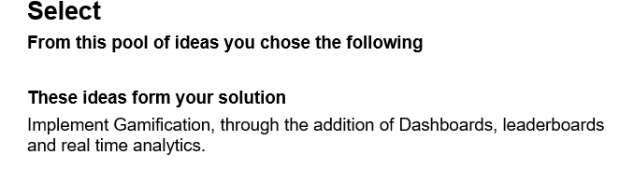
Introduction
Clear Ideas
Recommendation
Conclusion
Introduction
Case Objectives
Case Objectives
Research
Appraisal
Recommendation
Conclusion
Clear Ideas
Appraisal
Clear Ideas – Solution Formation

Slide 10
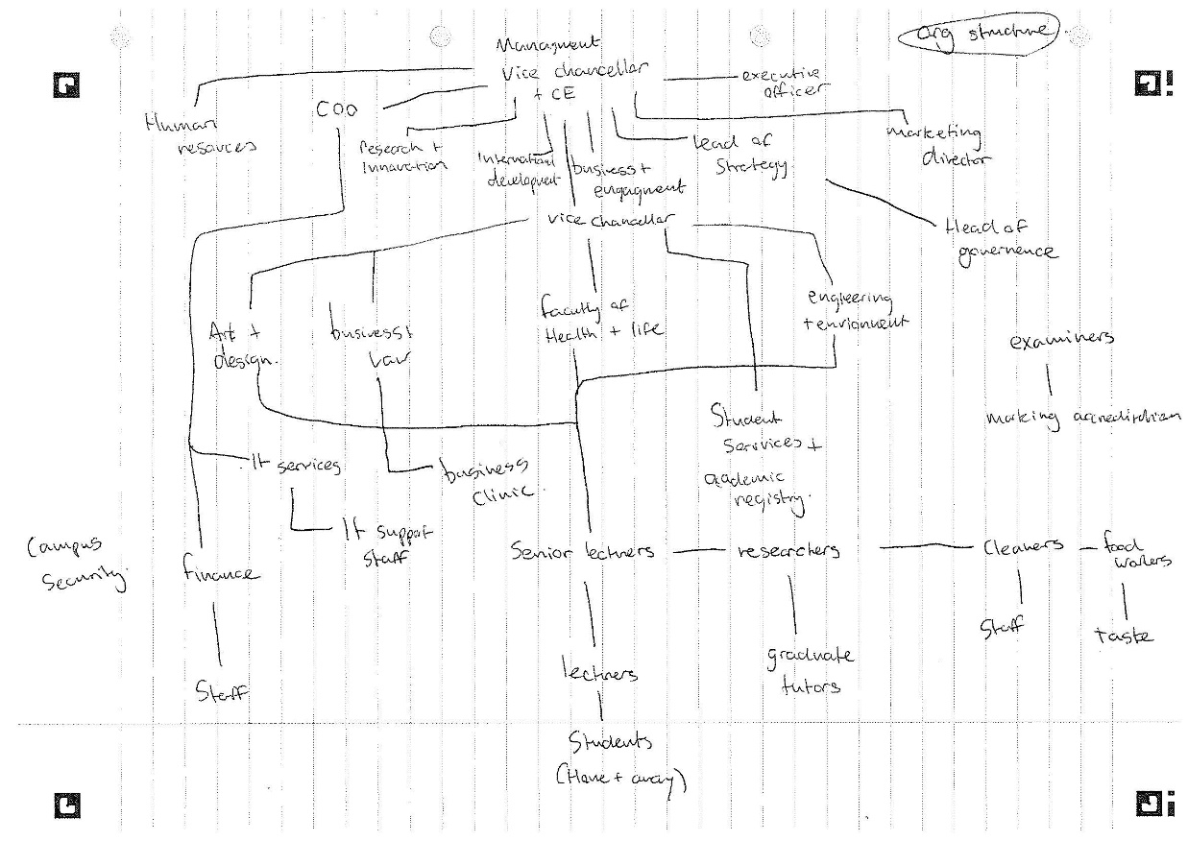

Introduction
Clear Ideas
Recommendation
Conclusion
Introduction
Case Objectives
Case Objectives
Research
Appraisal
Recommendation
Conclusion
Clear Ideas
Appraisal
Clear Ideas – Northumbria University Structure
Management
Lecturers/ Senior researchers
Internal Administration Staff
Students
External Stakeholders
(Northumbria University, 2019)

Slide 11
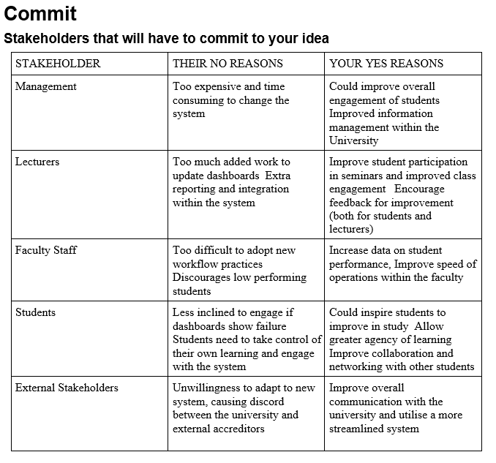
Introduction
Clear Ideas
Recommendation
Conclusion
Introduction
Case Objectives
Case Objectives
Research
Appraisal
Recommendation
Conclusion
Clear Ideas
Appraisal
Clear Ideas – Stakeholder engagement

Slide 12
Introduction
Case Objectives
Clear Ideas
Appraisal
Recommendation
Conclusion
Alternative LMS
Alternatives: Moodle, Blackboard, Canvas and TalentLMS
Moodle, Blackboard and Canvas are most influential in Medium to Large Higher Education Establishments
TalentLMS is mainly used in a business setting but adopts all necessary features
Adopt Web 2.0 and E-Business features such as web based application and SCROM applications.
Scalable and allow for the adoption of Big Data UI and gamification
Allow interoperability between business areas which satisfy stakeholders as found in secondary research
(Machado & Tao, 2007)

Slide 13
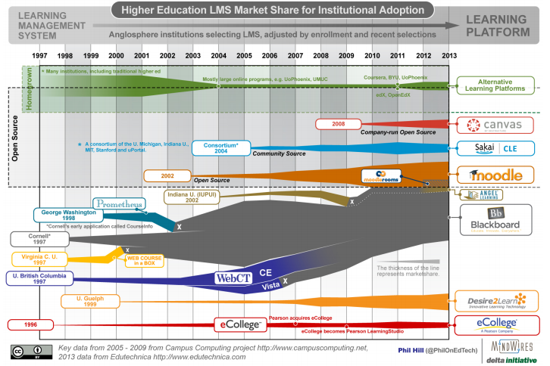
Introduction
Case Objectives
Clear Ideas
Appraisal
Recommendation
Conclusion
Alternative LMS
(Dahlstrom, Brooks & Bichsel, 2014)

Slide 14
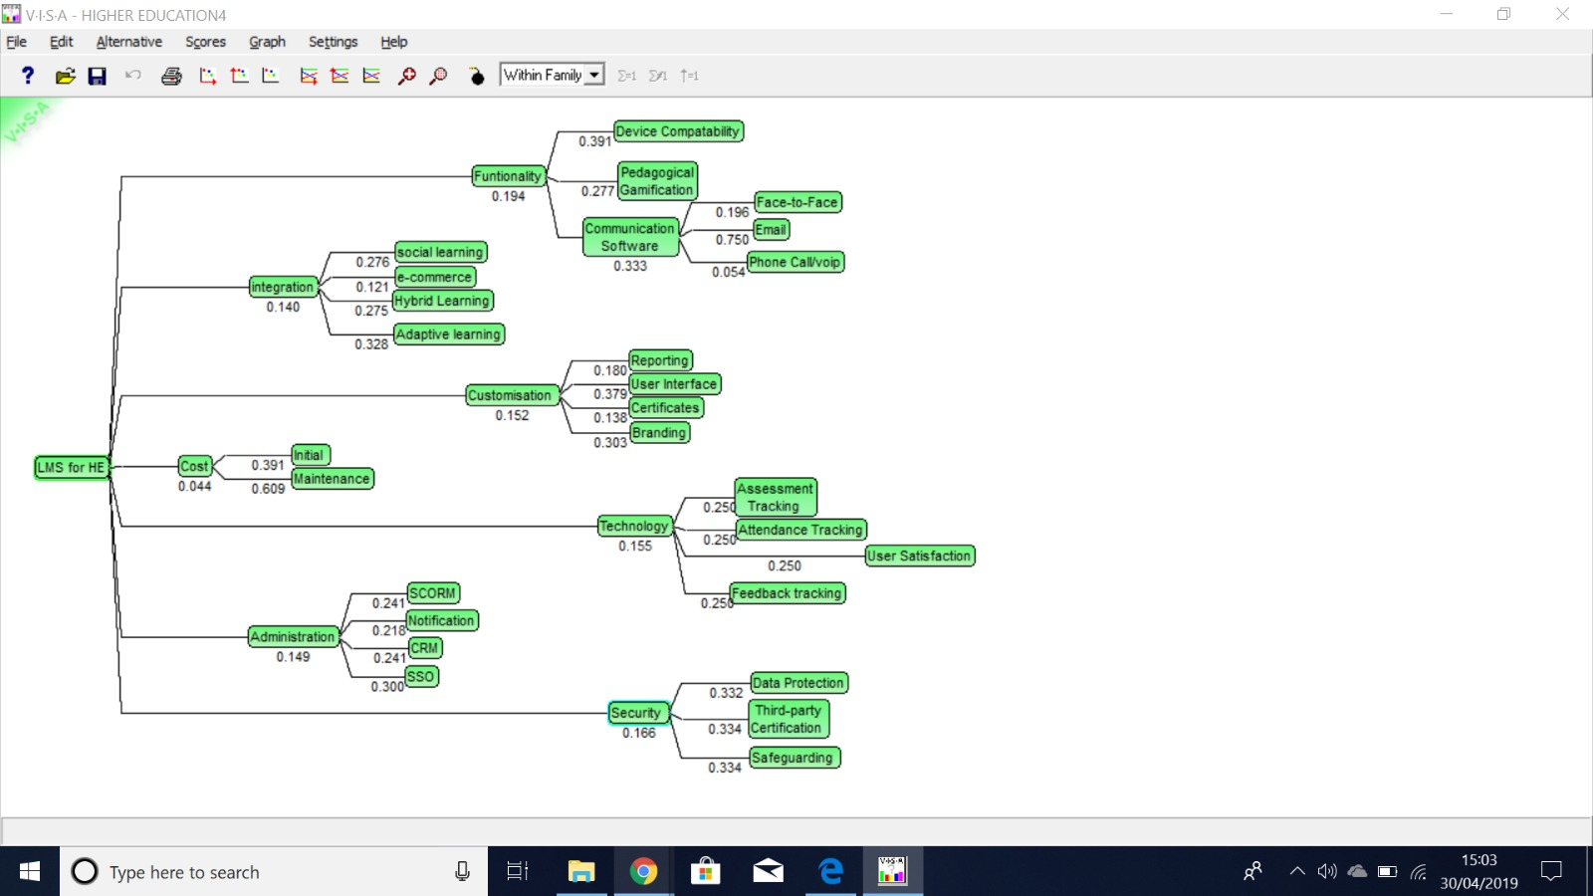
Introduction
Case Objectives
Clear Ideas
Appraisal
Recommendation
Conclusion
VISA Appraisal

Slide 15
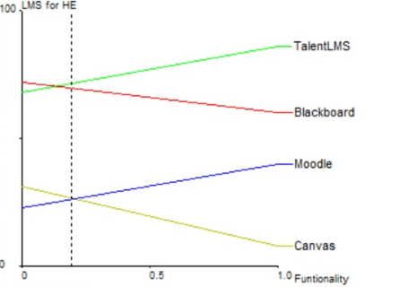
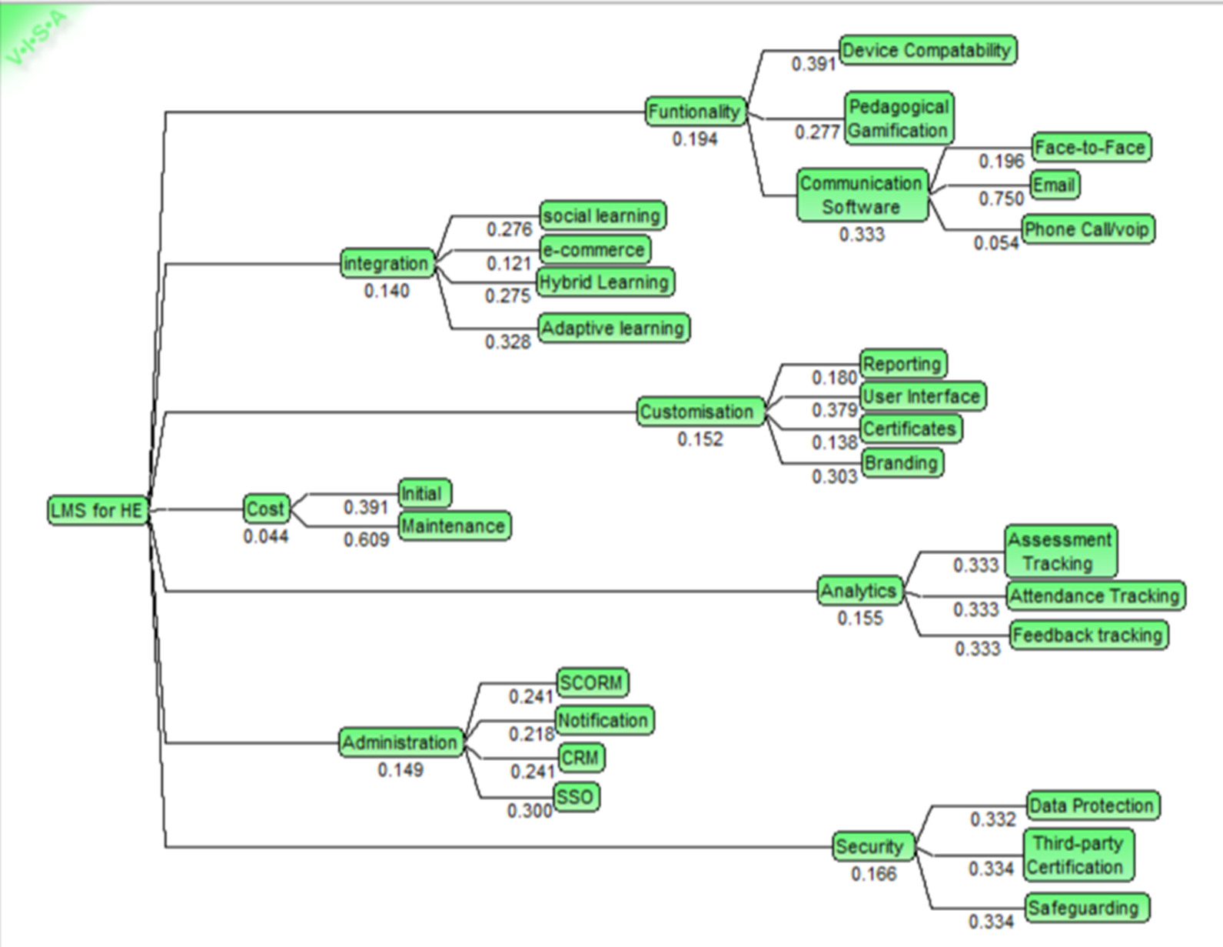
Introduction
Clear Ideas
Recommendation
Conclusion
Introduction
Case Objectives
Case Objectives
Research
Appraisal
Recommendation
Conclusion
Clear Ideas
Appraisal
VISA Appraisal
Gamification is important to modern LMS systems
Email is most predominantly used within HE institutions
(De-Marcos, Dominguez, Saenz-de-Navarrete, & Pages, 2014).

Slide 16

Introduction
Clear Ideas
Recommendation
Conclusion
Introduction
Case Objectives
Case Objectives
Research
Appraisal
Recommendation
Conclusion
Clear Ideas
Appraisal
VISA Appraisal
All types of learning using LMS are important to achieve success within HE
Communication and collaborative learning are imperative to successful LMS
(Veselinov, Kotevski, & Rendevski, 2018)

Slide 17
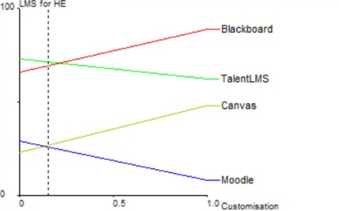
Introduction
Clear Ideas
Recommendation
Conclusion
Introduction
Case Objectives
Case Objectives
Research
Appraisal
Recommendation
Conclusion
Clear Ideas
Appraisal
VISA Appraisal
User Friendliness, Interface and experience scored highest through our research into LMS therefore takes the highest weighting
(Sclater, 2008)

Slide 18
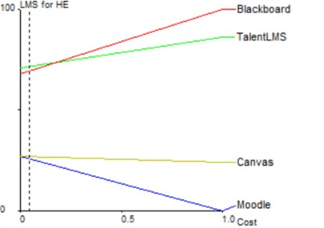
Introduction
Clear Ideas
Recommendation
Conclusion
Introduction
Case Objectives
Case Objectives
Research
Appraisal
Recommendation
Conclusion
Clear Ideas
Appraisal
VISA Appraisal
After an analysis of Northumbria University, the infrastructure and Blackboard Ultra System is already in place therefore most cost will come from maintenance of the system

Slide 19
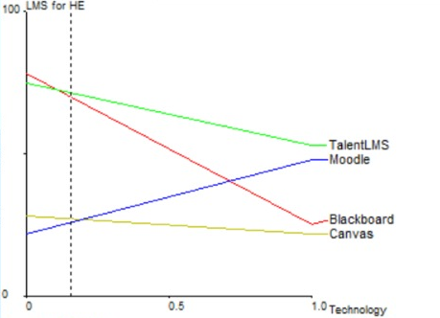
Introduction
Clear Ideas
Recommendation
Conclusion
Introduction
Case Objectives
Case Objectives
Research
Appraisal
Recommendation
Conclusion
Clear Ideas
Appraisal
VISA Appraisal
TalentLMS scored highest within the Technology currently within the LMS, however Blackboard Ultra uses building blocks to enhance technological capabilities
Satisfaction and Tracking achieve equal weighting due to the shared advantages of data. (Machado & Tao, 2007)

Slide 20

Introduction
Clear Ideas
Recommendation
Conclusion
Introduction
Case Objectives
Case Objectives
Research
Appraisal
Recommendation
Conclusion
Clear Ideas
Appraisal
VISA Appraisal
All Security concerns score equally as an LMS deals with personal data and must adhere to the Data protection act
We found that Blackboard scored highest among its competitors as it is not open source and therefore has a lower risk. (Dahlstrom, Brooks, & Bichsel, 2014)

Slide 21

Introduction
Clear Ideas
Recommendation
Conclusion
Introduction
Case Objectives
Case Objectives
Research
Appraisal
Recommendation
Conclusion
Clear Ideas
Appraisal
VISA Appraisal
Single Sign On (SSO) scored highest due to additional security considerations in terms of weighting
SCORM compliance is imperative to the success of LMS with regards to the adoption of web-based applications. (Wilson, Liber, Johnson, Beauvoir, Sharples, & Milligan, 2007)

Slide 22
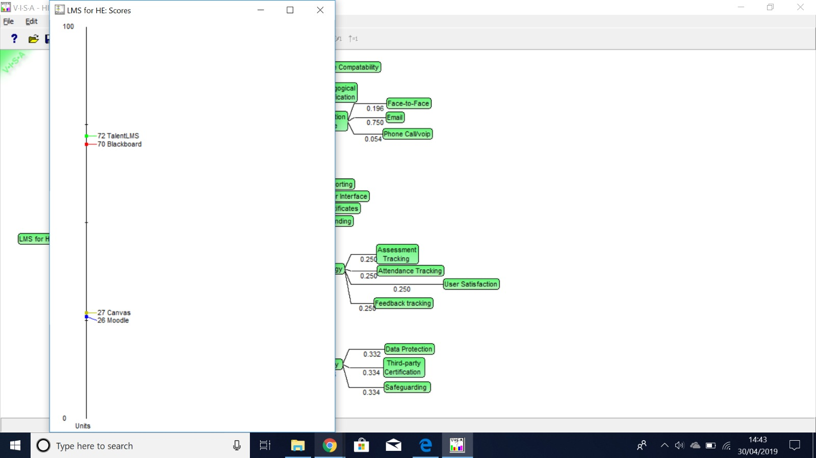
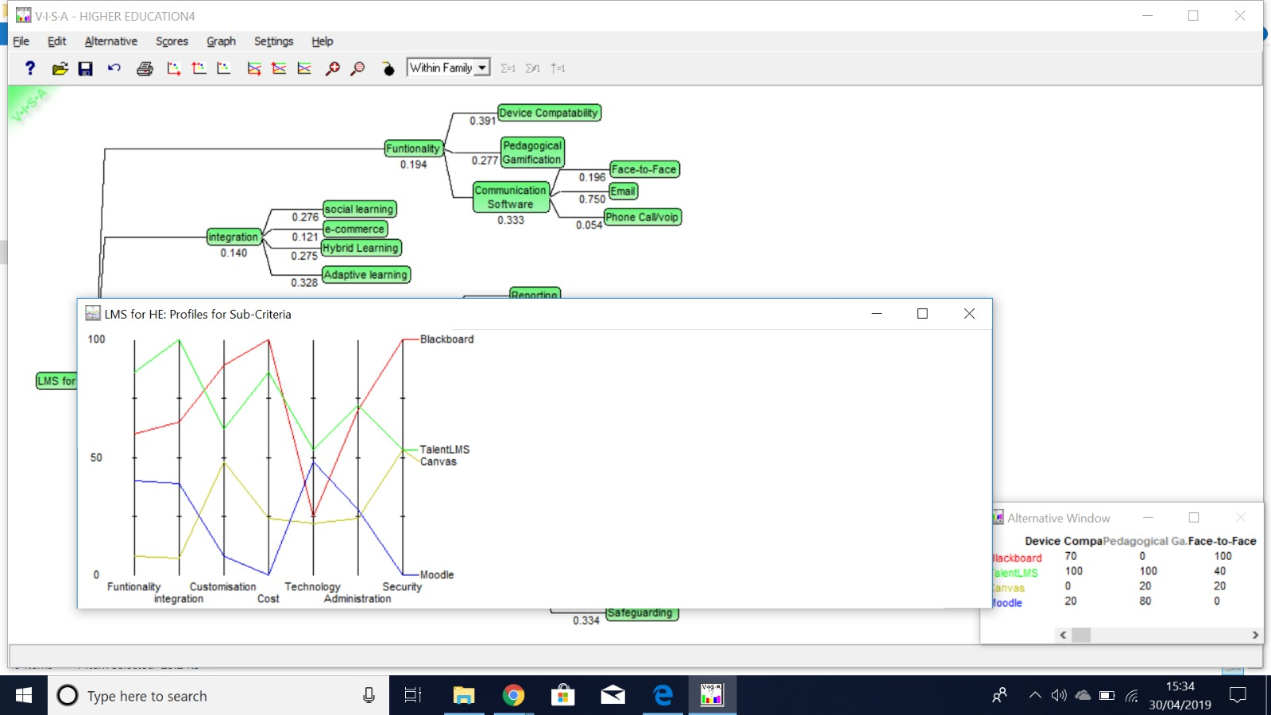
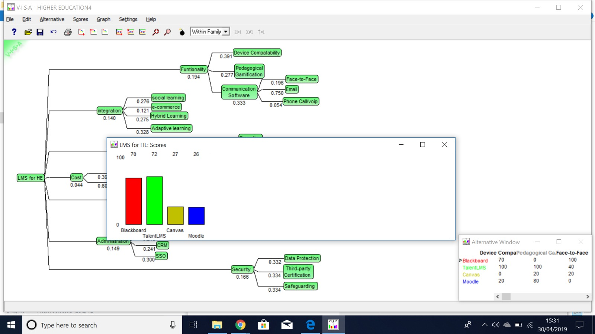

Introduction
Clear Ideas
Recommendation
Conclusion
Introduction
Case Objectives
Case Objectives
Research
Appraisal
Recommendation
Conclusion
Clear Ideas
Appraisal
VISA Appraisal

Slide 23
Introduction
Clear Ideas
Recommendation
Conclusion
Introduction
Case & Organisation
Case Objectives
Research
Appraisal
Recommendation
Conclusion
Clear Ideas
Appraisal
Recommendation
Through the VISA and prior research we recommend the University maintains the use of Blackboard Ultra, as it is used by Higher Education Institutions and therefore improvements can be made based on relevant feedback, compared to TalentLMS which may act on Business feedback.
However, we believe that the use of Blackboard should be extended with the use of external web-based applications, specifically to implement:
Real-time Dashboards for the enhancement of student interaction and learning management.
The Blackboard Ultra Building blocks Parature and Pronto to enhance student communication options and interaction
Improve training in File Management, ensuring that all files are uploaded in PDF format to improve server space management and ease of use.
All of which have proven to be desirable through both Primary and Secondary research

Slide 24
Introduction
Clear Ideas
Recommendation
Conclusion
Introduction
Case & Organisation
Case Objectives
Research
Appraisal
Recommendation
Conclusion
Clear Ideas
Appraisal
Conclusion
In conclusion, we believe that the analysis of the system reflected accurately on the student experience of using an LMS, however further insight could have been gained through access to systems used by lecturers and upper management within the university, however this remained outside of the SCOPE of our project.
Overall, the sensitivity analysis undertaken through VISA software remained accurate to the main features of an LMS within Higher Education, however some research we obtained may be applicable to K12 or Business and we believe that this was legitimately addressed.
This analysis remains realistic as through our access to the system we have obtained greater experience using most technical aspects; thus narrowing the SCOPE of our analysis and providing pertinent recommendations.

Slide 25
Introduction
Clear Ideas
Recommendation
Conclusion
Introduction
Case & Organisation
Case Objectives
Research
Appraisal
Recommendation
Conclusion
Clear Ideas
Appraisal
Thank You for Listening
Any Questions?

Slide 26
Introduction
Case & Organisation
Research
Clear Ideas
Appraisal
Recommendation
Conclusion
References
Bremer, D., Bryant, R. (2005). A Comparison of Two Learning management Systems: Moodle vs Blackboard, Proceedings of the 18th Annual Conference of the National Advisory Committee on Computing Qualifications, pp. 135-139.
Dahlstrom, E., Brooks, C. & Bichsel, J. (2014). The Current Ecosystem of Learning Management Systems in Higher Education: Student, Faculty, and IT Perspectives. Retrieved from: https://www.educause.edu/ecar
De-Marcos, L., Dominguez, A., Saenz-de-Navarrete, J. & Pages, C. (2014). An empirical study comparing gamification and social networking on e-learning. Computers & Education, 75, pp. 82-91. Retrieved from: https://doi.org/10.1016/j.compedu.2014.01.012
Dias, S. B., Diniz, J. A. (2014). Towards an Enhanced Learning Management System for Blended Learning in Higher Education Incorporating Distinct Learners' Profiles. Journal of Educational Technology & Society, 17(1), pp. 307-319.
Dobre, J. (2015). Learning Management Systems for Higher Education - An Overview of Available Options for Higher Education Organizations. Procedia – social and behavioural sciences, 180, PP. 313-320. Retrieved from: https://doi.org/10.1016/j.sbspro.2015.02.122
Falvo, D., Johnson, B. (2007). The use of learning management systems in the united states. Techtrends, 51(2), pp. 40-45. Retrieved from: https://link.springer.com/content/pdf/10.1007%2Fs11528-007-0025-9.pdf
Jadhav, R., Khaiwade, A., Sriram, V.P. (2018). THE RISING FOCUS OF LEARNING MANAGEMENT SYSTEM ON HIGHER EDUCATION - A FUTURE PERSPECTIVE, Proceedings of International Conference on Advances in Computer Technology and Management (ICACTM), pp. 15-18.
Machado, M., Tao, E. (2007). ‘Blackboard vs. Moodle: Comparing user experience of learning management systems’, 2007 37th Annual Frontiers In Education Conference, Global Engineering: Knowledge Without Borders, Opportunities Without Passports. Milwaukee, WI., 10-13 Oct. 2007. Piscataway, NJ.: IEEE.

Slide 27
Introduction
Case & Organisation
Research
Clear Ideas
Appraisal
Recommendation
Conclusion
References
Miyazoe, T. (2008). ‘LMS-based EFL blended learning: Blackboard vs Moodle.’, JALT2007:Conference Proceedings. Tokyo, June 2007. Tokyo: JALT, pp. 745-754.
Northumbira University. (n.d). University Management Structure. Retrieved from: https://www.northumbria.ac.uk/media/2077655/june-2014-ue-organisation-chart.pdf
Sclater, N. (2008) Web 2.0, Personal Learning Environments, and the future of Learning Management Systems. EDUCAUSE Centre for applied Research, Research Bulletin, 2008(13). Retrieved from: https://www.educause.edu/ecar.
Stone, D., Zheng, G. (2014). Learning management systems in a changing environment (2nd ed.) Handbook of Research on Education and Technology in a changing society (pp. 756-767). Hershey, PA: IGI Global.
Veselinov, I., Kotevski, Z., Rendevski, N. Architecture for Multimedia Learning System With Social Networking Features, International Conference on Applied Internet and Information Technologies, 2018, pp. 135-140. DOI:10.20544/AIIT2018.P29
Vovides, Y., Sanchez, A., Mitropoulou. V. & Nickmans, G. (2007). The use of e-learning course management systems to support learning strategies and to improve self-regulated learning. Educational Research Review, 2, pp. 64-74.
Weiler, H. (2004). Challenging the Orthodoxies of Knowledge: Epistemological, Structural, and Political Implications for Higher Education, Colloquium on Research and Higher Education Policy of the UNESCO Forum on Higher Education, Research, and Knowledge, Paris, December 1-3, 2004.
Wilson, S., Liber, O., Johnson, M., Beauvoir, P., Sharples, P. & Milligan, C. (2007). Personal Learning Environments: Challenging the dominant design of educational systems. Journal of e-Learning and Knowledge Society, 3(2), 27-38. Italian e-Learning Association. Retrieved From: https://www.learntechlib.org/p/43419/.

Slide 28
Introduction
Case & Organisation
Research
Clear Ideas
Appraisal
Recommendation
Conclusion
Appendices
Appendix 1 - https://docs.google.com/forms/d/1j5L9nkIoUdOK5IfyVfe2FxBjydg48mVoizz9VaIlgf8/edit#responses
Appendix 2 -
Political | Economic | Social | Technological | Environmental | Legal
Increasing commercialisation of knowledge The politicisation of finance and sponsorship in HE | Cost of maintaining IT Systems/SaaS The increasing economic value of knowledge | Increasing demand for collaboration software Students not satisfied with engagement features Greater awareness of security risks | Mobile platforms account for most web usage Applications for mobile systems LMS increasingly rely on web-based application integration Scalable LMS systems availability Communication channel improvement LMS not supportive of personalisation | Reduction of paper based learning materials | GDPR Licensing & Patent rights

